Slide 1
School
Extreme
Violence
Brig Gen (ret’d) John Galatas, MD
Senior Asymmetric Threats Analyst
Athens, Greece

Slide 2
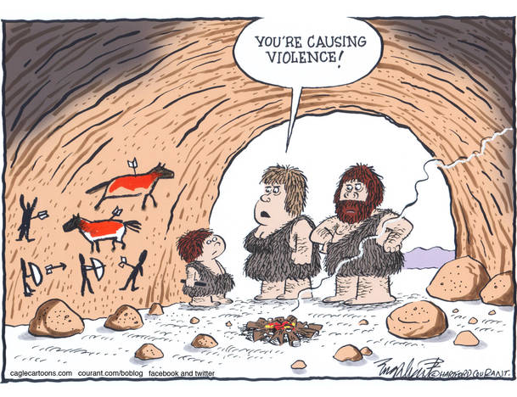
OUTLINE
School violence – a global problem
School terrorism
Risk management
Vulnerability assessment
Continuity plan
Training
Some proposals for now

Slide 3
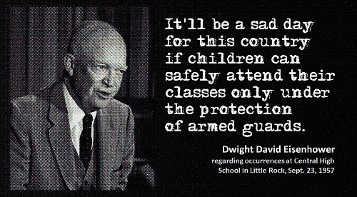
Guns & Schools
On 4 September 1957, the first day of school at Central High, a white mob gathered in front of the school,
and Governor Orval Faubus deployed the Arkansas National Guard to prevent the black students (Little Rock Nine) from entering.

Slide 4
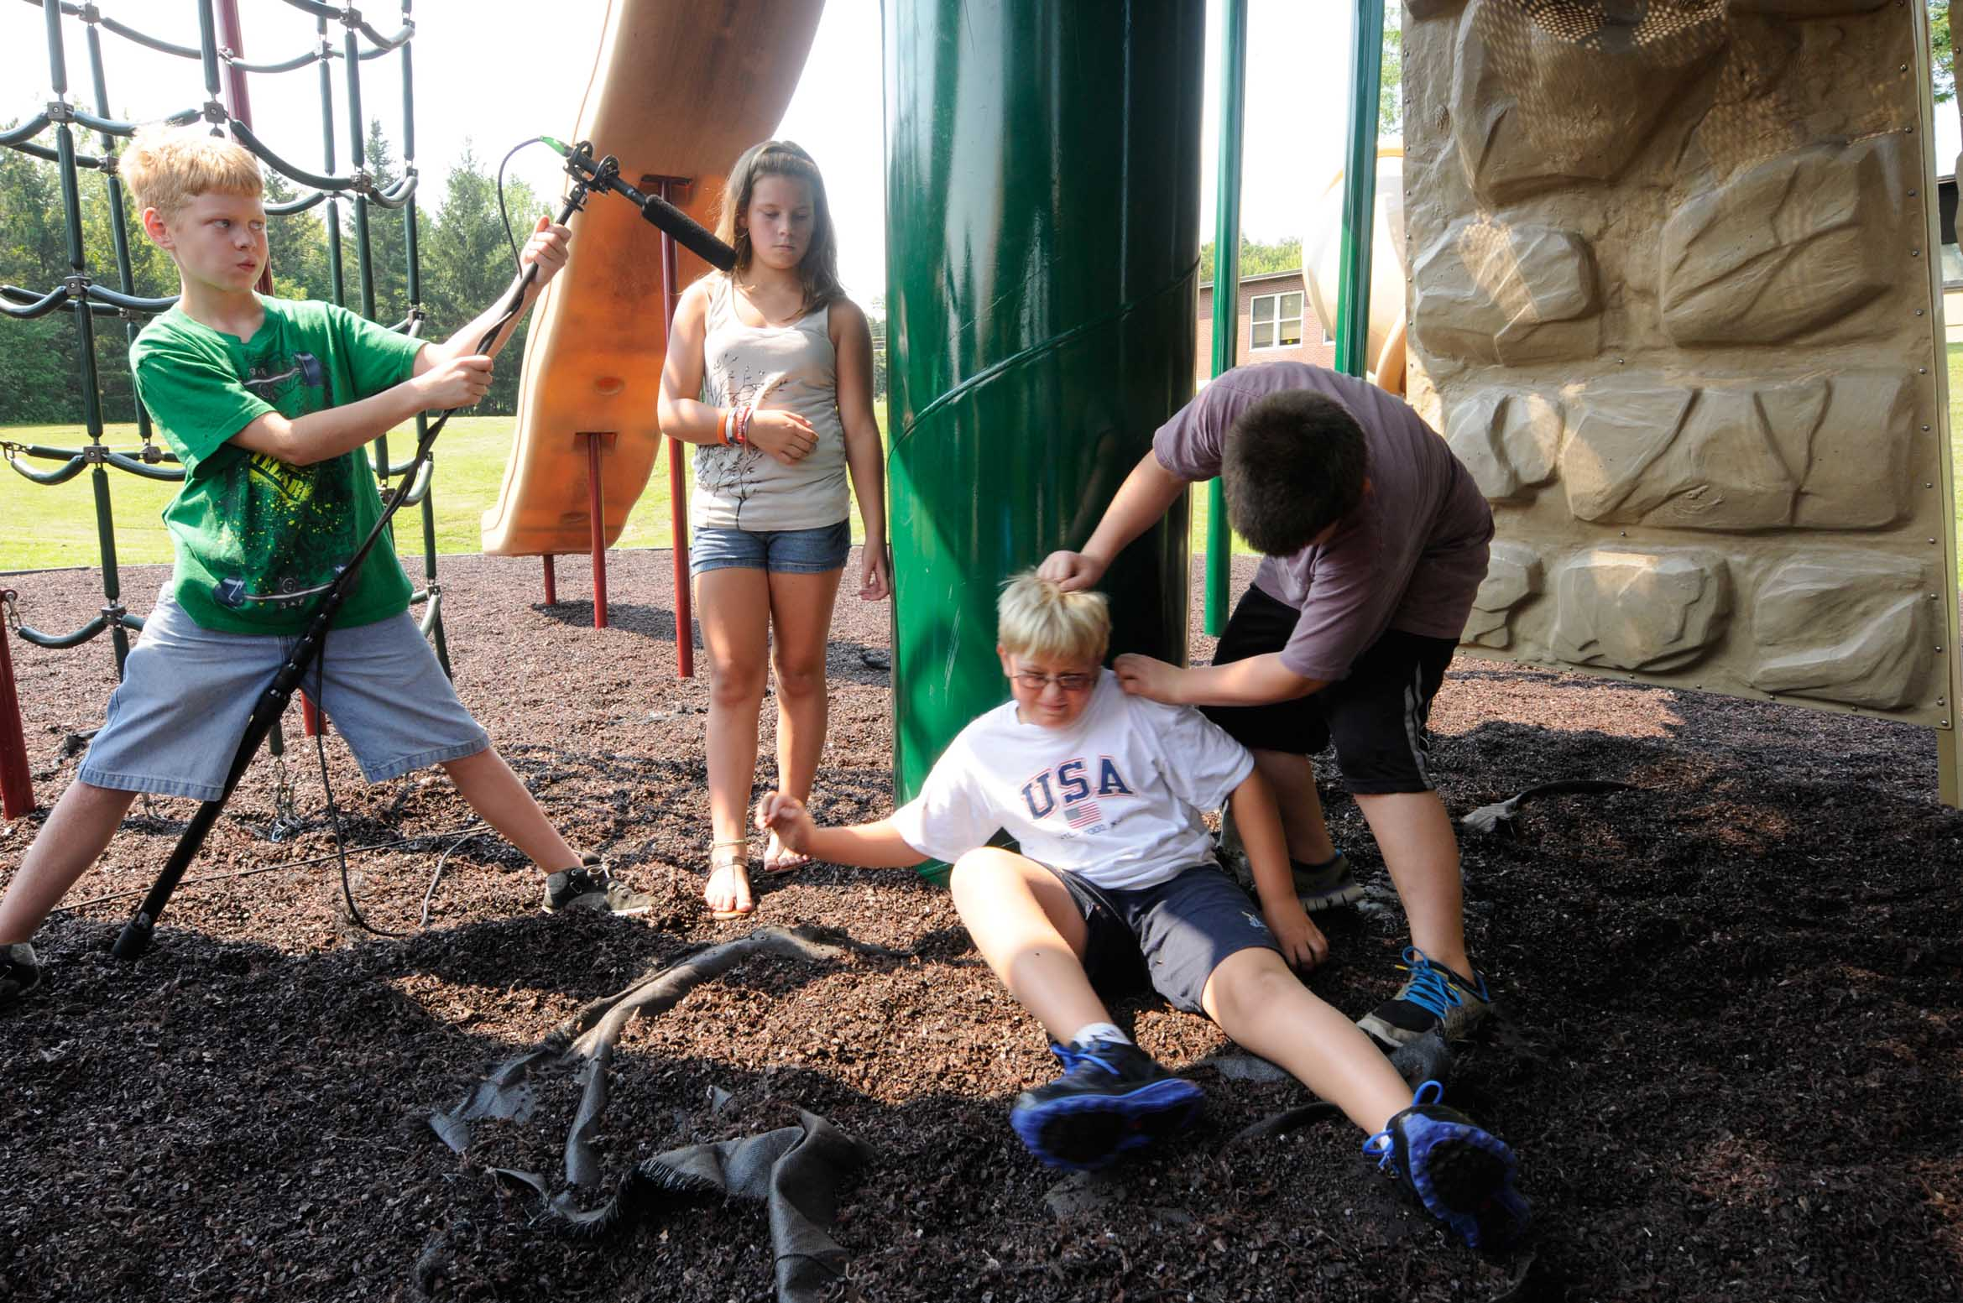
Guns & Schools

Slide 5
A global problem
Australia
State of Queensland
55,000 students suspended (2008) – 1/3rd for "physical misconduct"
South Australia (2008-2009)
175 violent attacks against students or staff
Students cause 3,000 injuries reported by teacher
Western Australia
46% of Principals have been either physically assaulted or witnessed physical violence in schools during 2012
70% of school leaders had also been threatened with violence
Belgium
Francophone Belgium – violence: a significant factor ➔ to leave the teaching profession
Bulgaria
2009 – Teachers were to be given new powers to punish disruptive students
France
2000 – 39 out of 75,000 state schools were "seriously violent" and 300 were "somewhat violent“
Japan
Students at public schools were involved in a record number of violent incidents in 2007
 52,756 cases, an increase of some 8,000 on the previous year
 in 7,000 of these incidents, teachers were the target of assault
South Africa
40% of children = victims of crime at school
 >1/5th of sexual assaults on children took place in schools

Slide 6
A global problem
Poland
In 2006, in response to the suicide of a girl after she was sexually molested in school
 "zero tolerance" school reform
Teachers would have the legal status of civil servants, making violent crimes against
them punishable by higher penalties. Head teachers (equivalent to principals in the US)
will be able to send aggressive pupils to perform community service and these students‘
parents may also be fined. Teachers who fail to report violent acts in school could face
a prison sentence
United Kingdom
1989 – 2% of teachers had reported facing physical aggression
2007 – survey of 6,000 teachers: >16% claimed to have been physically assaulted by students in the previous two years
2007 – 7,000 cases of the police being called to deal with violence in schools
2009 – survey of1,000 teachers: 1/4 of them had been on the receiving end of physical violence by a student
Wales (2009) – 2/5th of teachers reported having been assaulted in the classroom
 49% had been threatened with assault
United States
CDC (2007) – 12 months study
5.9% of students carried a weapon (e.g. gun, knife, etc.) on school property (MX3 vs. F)
7.8% of HS students reported having been threatened or injured with a weapon on school property at least once (MX2 vs. F)
12.4% of students had been in a physical fight on school property at least once (MX2 vs. F)
5.5% of students reported that because they did not feel safe, they did not go to school on at least one day (M=F)
7% (10% in urban schools) of teachers in 2003 were subject to threats of injury by students
5% of teachers in urban schools were physically attacked, with smaller percentages in suburban and rural schools

Slide 7
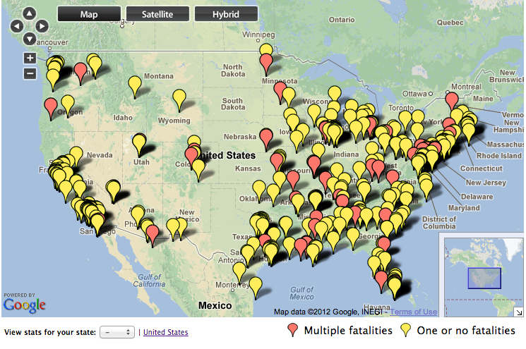
A US problem
A map of all the schools shootings in the U.S. since 1992
http://www.geekwire.com/2012/whitepage-ceo-develops-school-shootings/

Slide 8
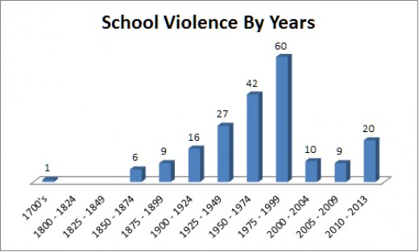
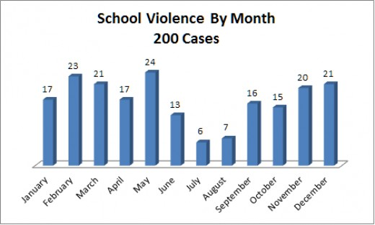
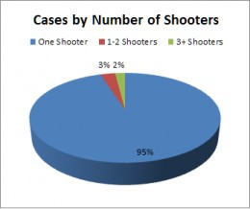
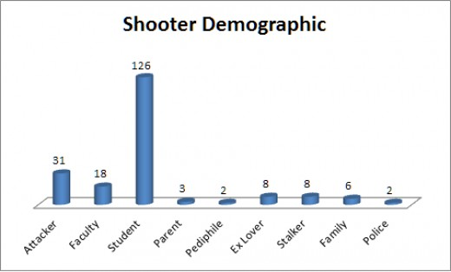
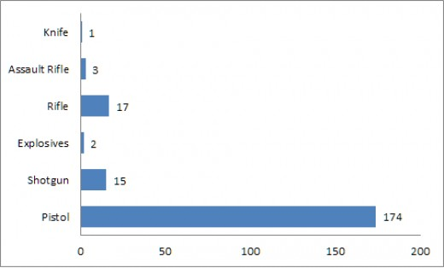
A US problem
http://jwilliams61735.hubpages.com/hub/Brief-of-the-History-and-Analysis-of-US-School-Violence

Slide 9
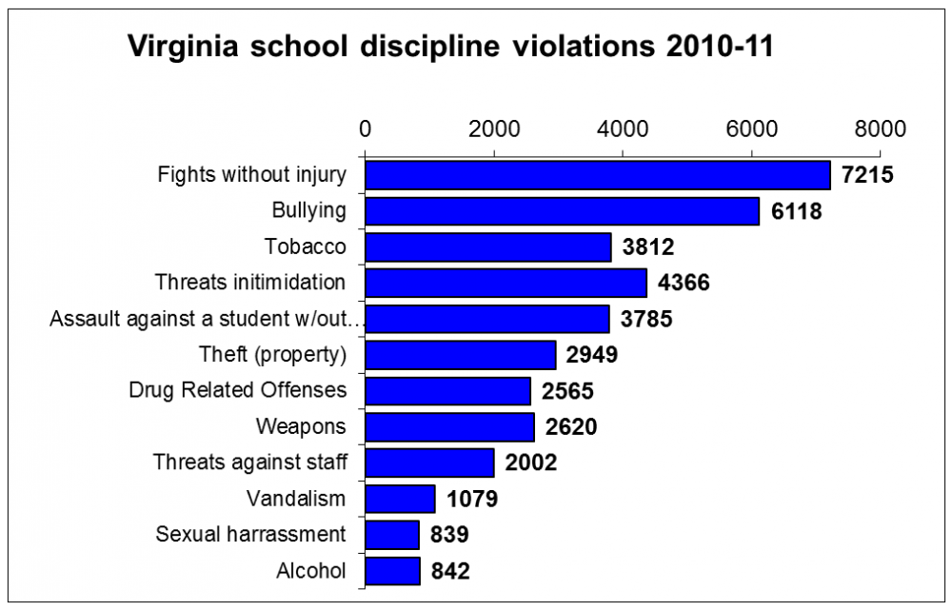
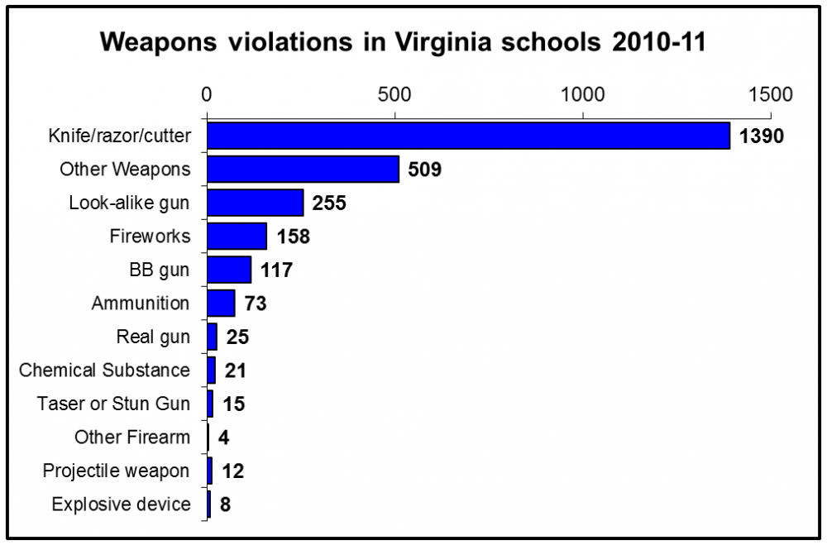
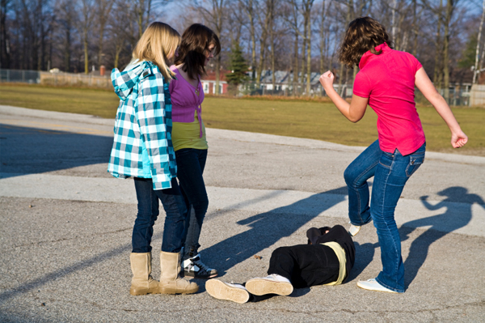
A US problem
http://curry.virginia.edu/research/projects/violence-in-schools/virginia-statistics

Slide 10
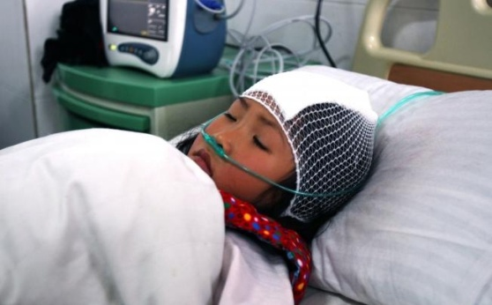
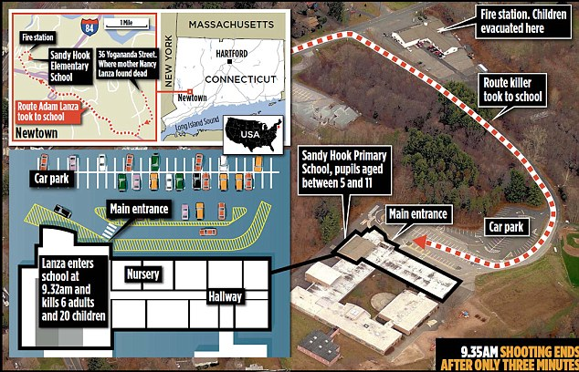
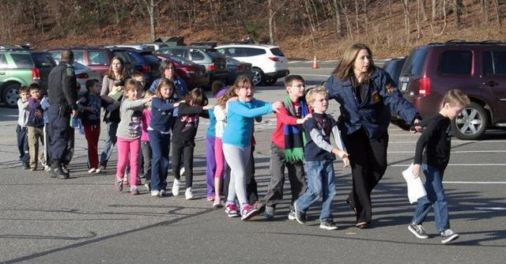
A US problem
Location | Sandy Hook, Connecticut, U.S.
Date | December 14, 2012 c. 9:35 am – c. 9:40 am
Target | Students and staff at Sandy Hook Elementary School
Attack type | School shooting, murder–suicide, matricide, spree shooting
Deaths | 28 total; 27 at the school (including perpetrator) and perpetrator's mother (at home)
Injured (non-fatal) | 2
Perpetrator | Adam Peter Lanza Born: April 22, 1992

Slide 11
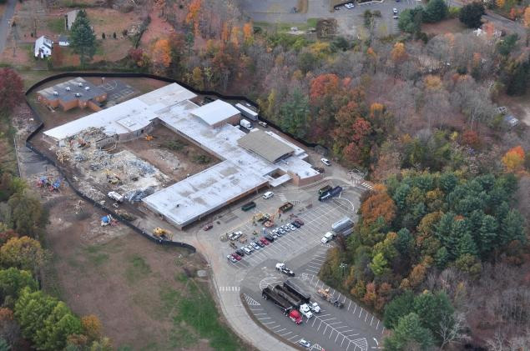
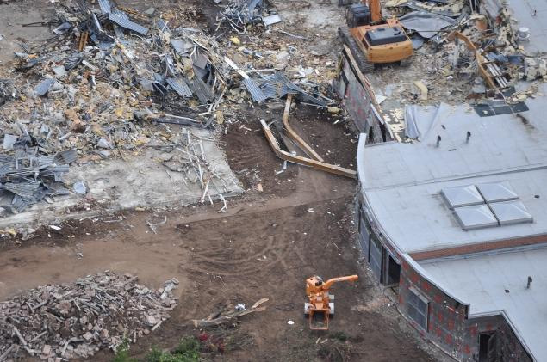
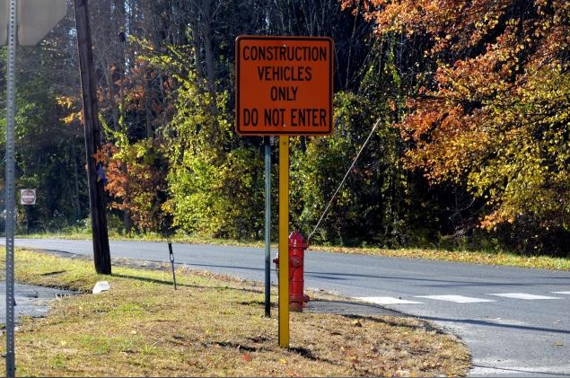
A US problem

Slide 12
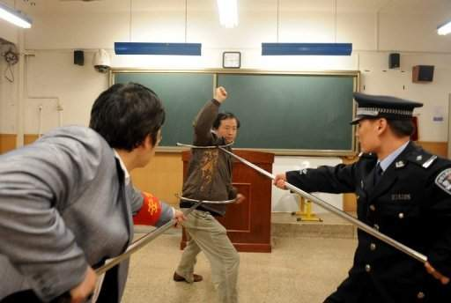
An international problem
CHINA: March 2010 – Dec 2012
Mass school stabbings: 25 dead; 115 injured
A cheap but effective way to confront a man with a knife

Slide 13
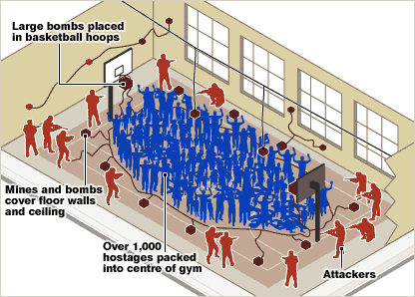
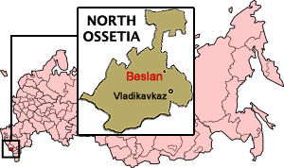
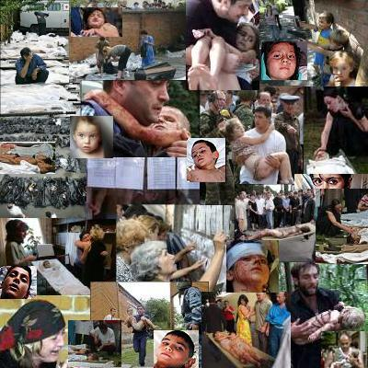
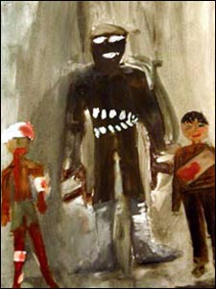
School terrorism
Beslan school siege or Beslan Massacre began when armed Muslim terrorists took more than 1200 school children and adults hostage on 1 September 2004, at School Number One (SNO) in the Russian town of Beslan in North Ossetia.
Fatalities : at least 385
Injured : ~783
2004
Tree of Grief

Slide 14
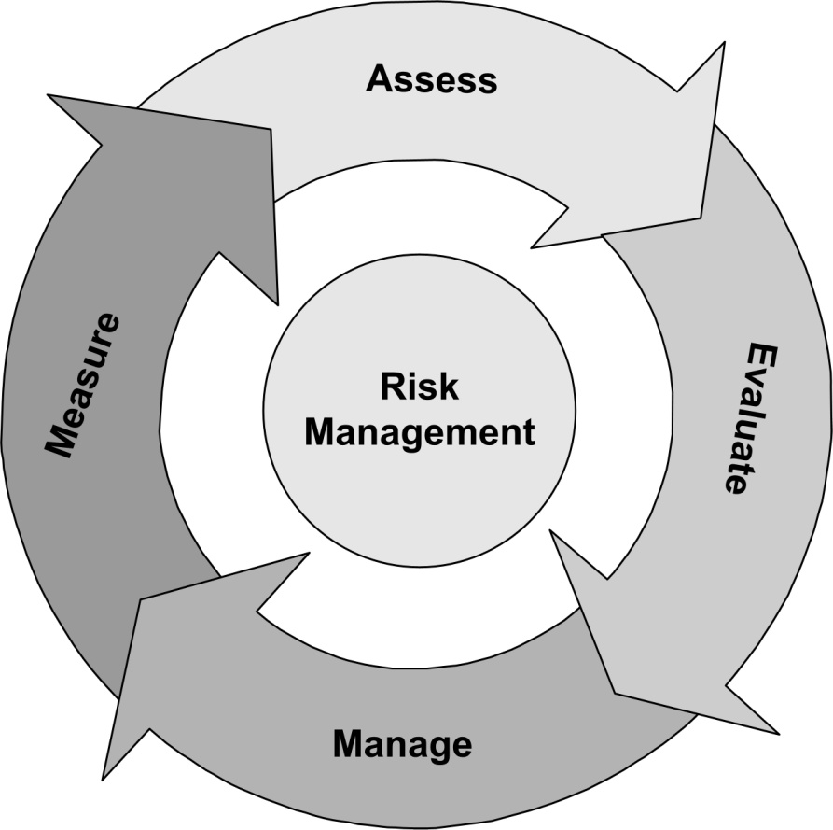
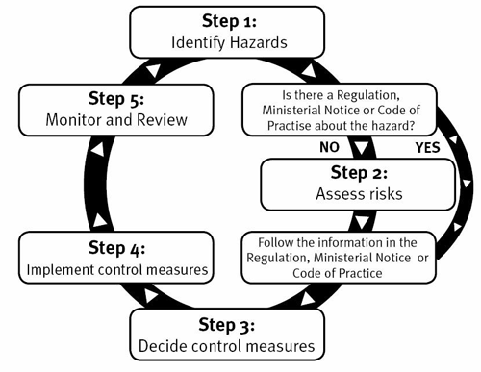
Risk management

Slide 15
Risk management
http://training.fema.gov/EMIWeb/emischool/EL361Toolkit/assets/SamplePlan.pdf

Slide 16
Risk factors
The individual child
Internalizing behaviors: withdrawal, inhibition, anxiety, and/or depression;
Externalizing behaviors: delinquent activities, aggression, and hyperactivity;
Unlike internalizing behaviors, externalizing behaviors include, or are directly linked to, violent episodes
Other individual factors
Early starters ►worse prognosis in terms of future aggression & antisocial activities;
Lower IQ ► related to higher levels of aggression;
Boys ► early problematic motor skills, attention difficulties, and reading problems predict later persistent antisocial conduct
Home environment
Home environment contributes to school violence;
 exposure to gun violence, parental alcoholism, domestic violence, physical abuse of the child,
harsh parental discipline and child sexual abuse
 exposure to television violence and, to a lesser extent, violent video games
Neighborhood environment
Communities with high rates of crime and drug use teach youth the violent behaviors that are carried into school;
Poverty and high population densities are associated with higher rates of school violence;
Exposure to community violence during early elementary school = increased risk of aggression in elementary school;
Neighborhood gangs are contribute to dangerous school environments.
School environment
Teacher assaults associated with:
higher percentage of male faculty;
higher proportion of male students, and
higher proportion of students receiving free or reduced cost lunch (an indicator of poverty)

Slide 17
Prevention & intervention
4-Level CDC’s Proposals
Society-level prevention strategies
 i.e. reducing media violence, reshaping social norms, and restructuring educational systems
 strategies are rarely used and difficult to implement
School-wide strategies
 i.e. schools promote classroom management techniques, cooperative learning, close student supervision,
Good Behavior Game [elementary school], Second Step curriculum [2nd and 3rd graders], reducing or
eliminating bullying and organizing the local police to better combat gang violence
School-wide early-warning systems
 i.e. early threat assessment, violence-prevention efforts, anti-bullying programs, helping teachers with
classroom-management strategies, behavioral strategies, implementing curricular innovations,
programs to strengthen families
Individual-level strategies
 i.e. conflict resolution and team problem-solving, teaching students social skills

Slide 18
Vulnerability assessment

Slide 19
Vulnerability assessment

Slide 20
Vulnerability assessment
“If you know the enemy and know yourself, you need not fear the result of a hundred battles. If you know yourself but not the enemy, for every victory gained you will also suffer a defeat. If you know neither the enemy nor yourself, you will succumb in every battle”
Sun Tzu, The Art of War, Special Edition

Slide 21
Vulnerability analysis
cool
safe

Slide 22
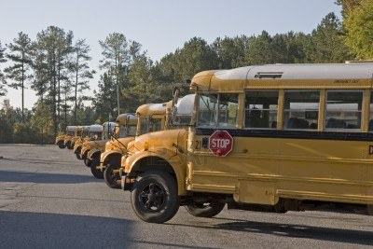
Vulnerability analysis
Who should be inside school premises?
Teaching staff
Students
Security personnel
Support staff (permanent)
Who could be occasionally inside school premises?
Catering/food provision staff
Maintenance staff
Construction staff
Parents and relatives of students
Other students and teachers
How do people enter school’s premises?
On foot
By cars, bicycles, motorbikes, buses, utility vehicles

Slide 23
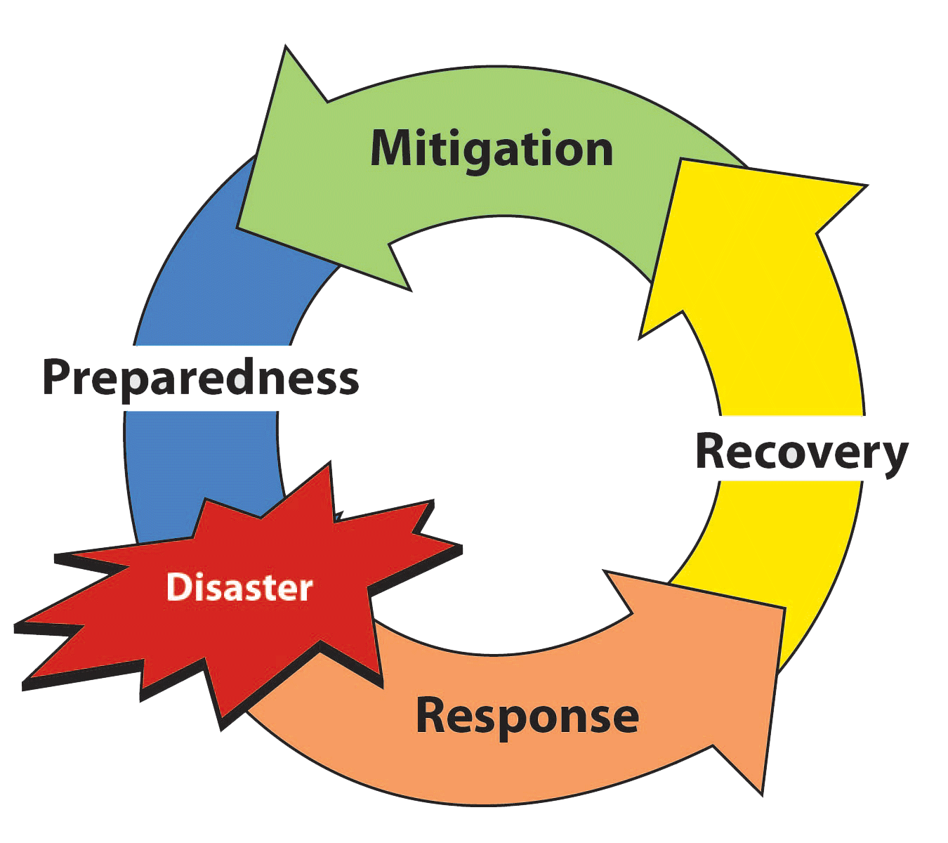
Vulnerability analysis
3
AnthropoCentric Planning
Greek
 Anthropos + Kentro
Man + Center
2
1

Slide 24
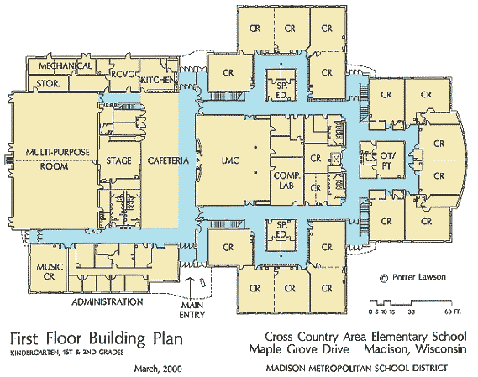
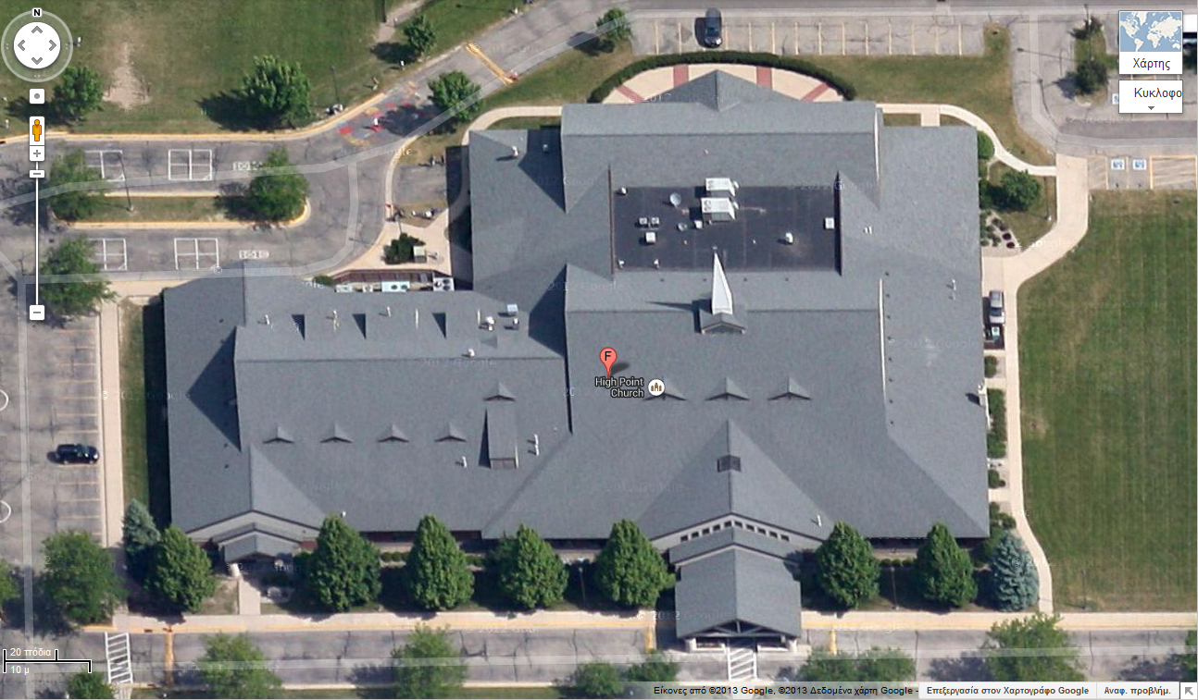
Vulnerability analysis
Are your blueprints on the Internet?

Slide 25
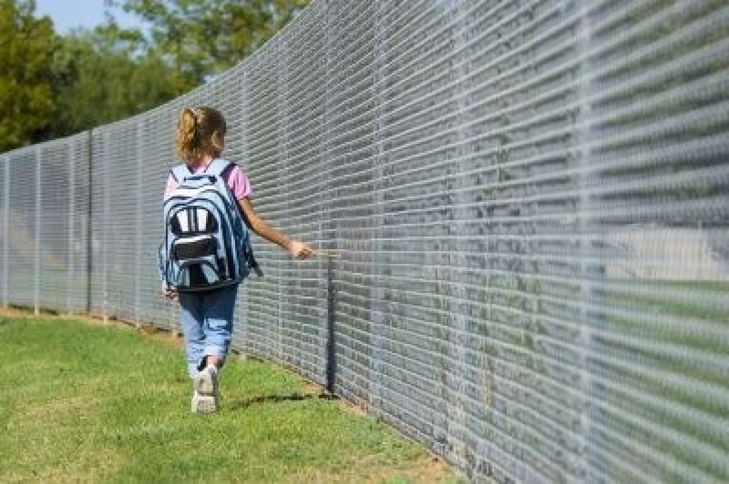
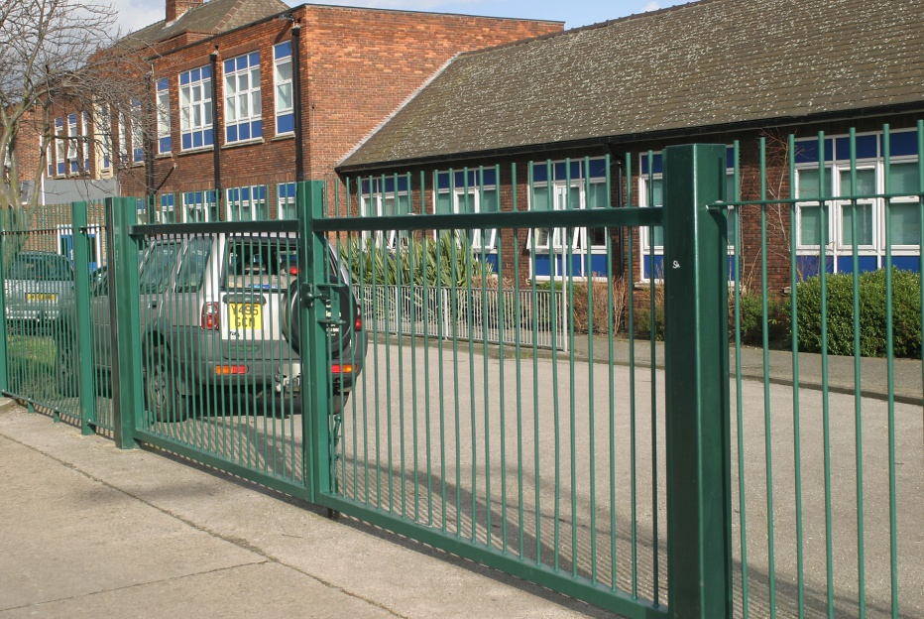
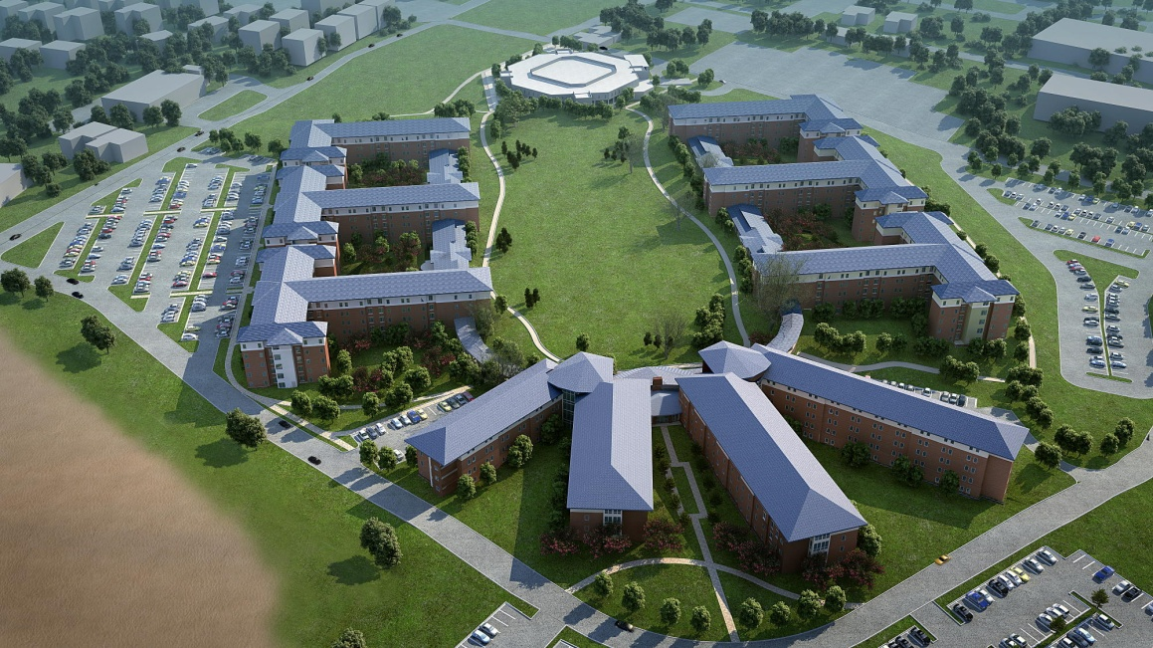
Vulnerability analysis
Is there a fence defining school?

Slide 26
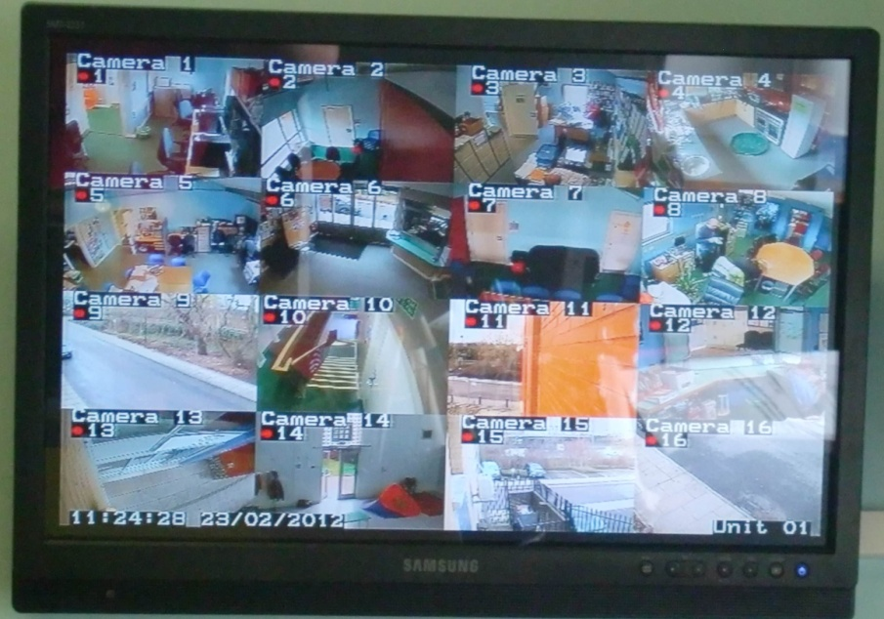
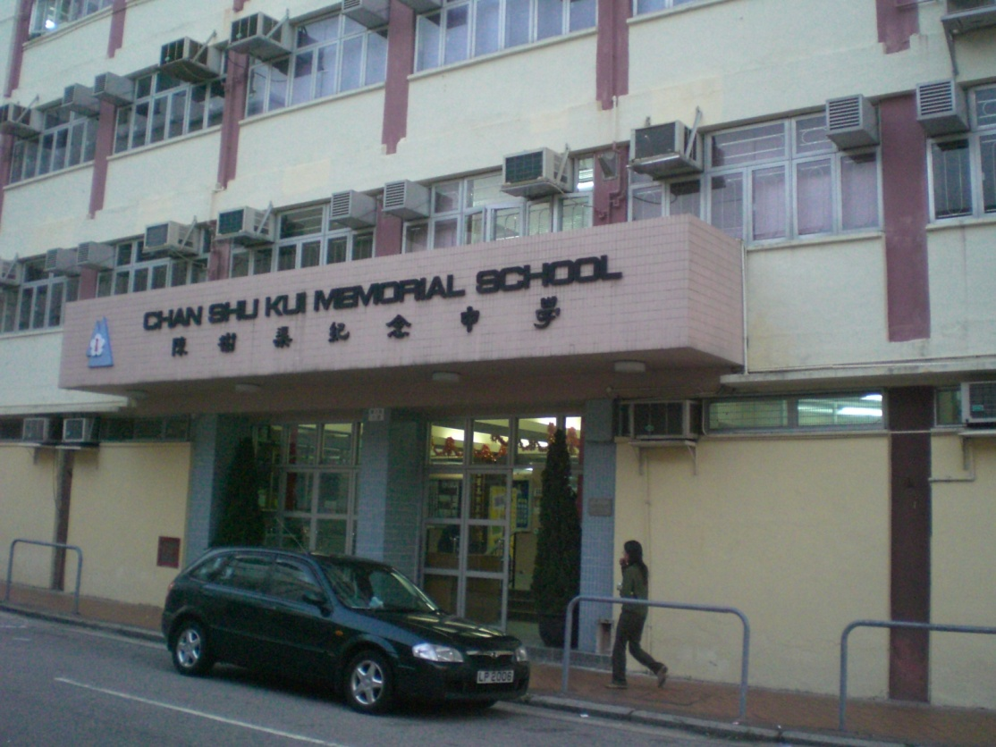
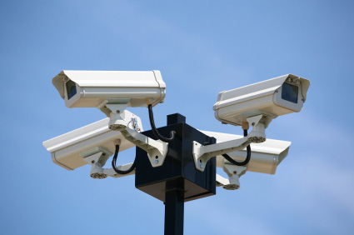
Vulnerability analysis

Slide 27
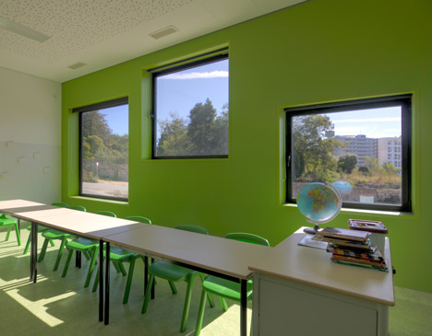
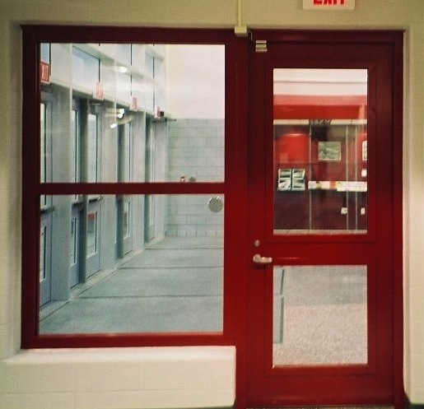
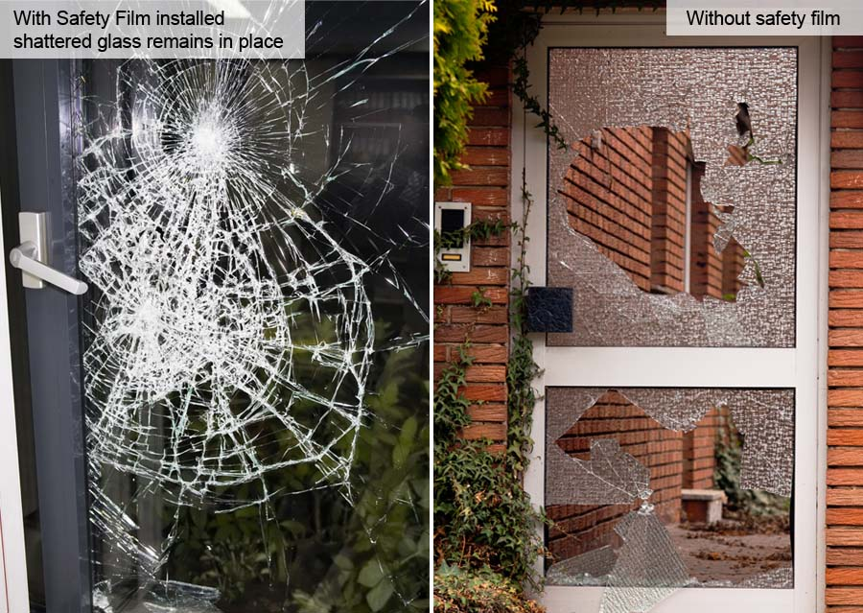
Vulnerability analysis
Shattered glass pieces
act as secondary bullets responsible
for 90% of blast injuries
Are your ground floor doors
and windows secured?

Slide 28
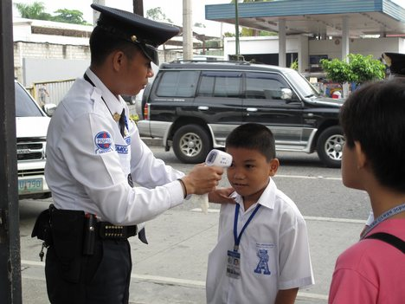
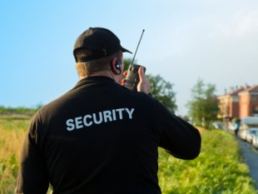
Vulnerability analysis
Background check
Training record
Psychological evaluation
Physical condition

Slide 29
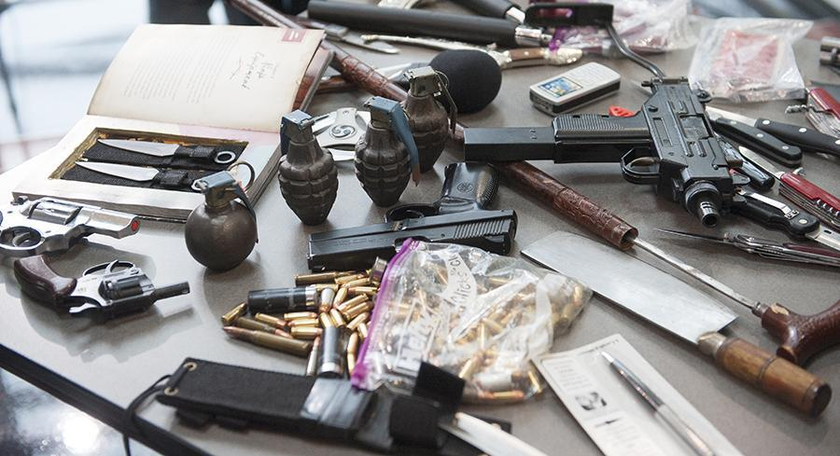
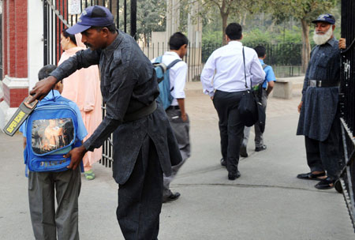
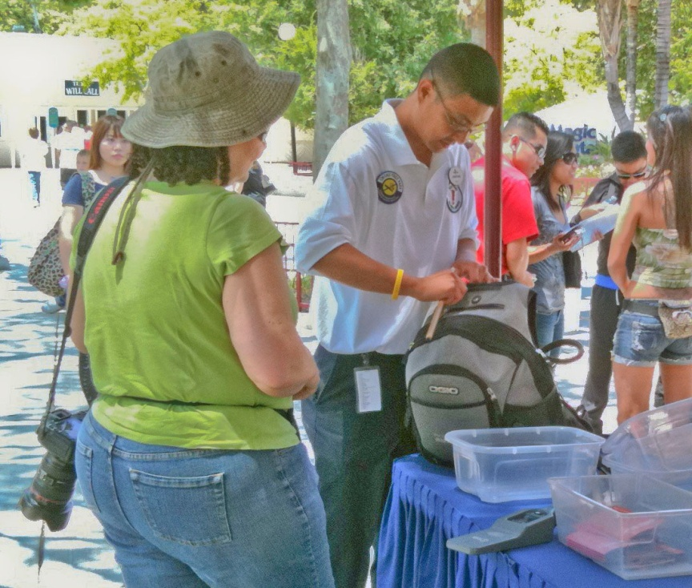
Vulnerability analysis
Sig P226 Cerakote Pistol

Slide 30
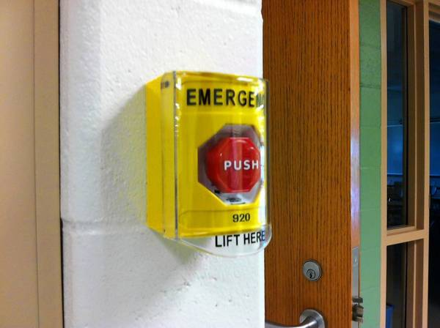
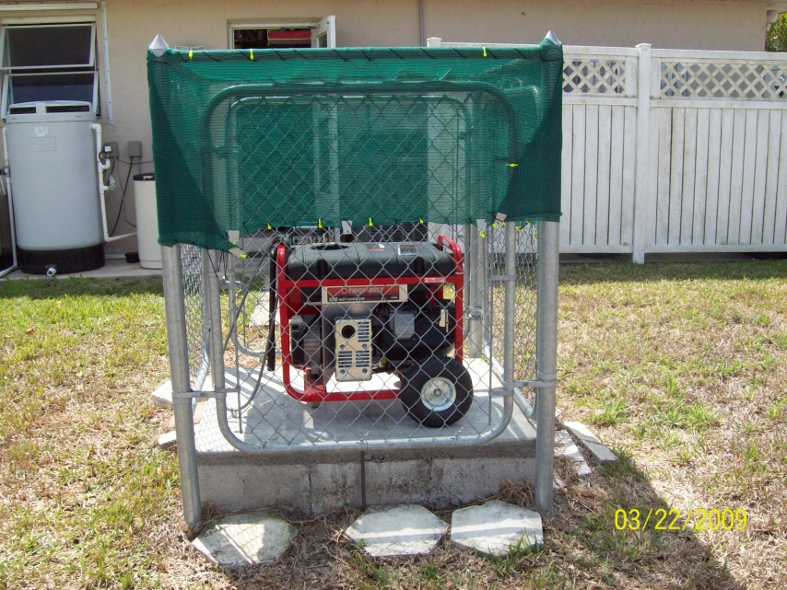
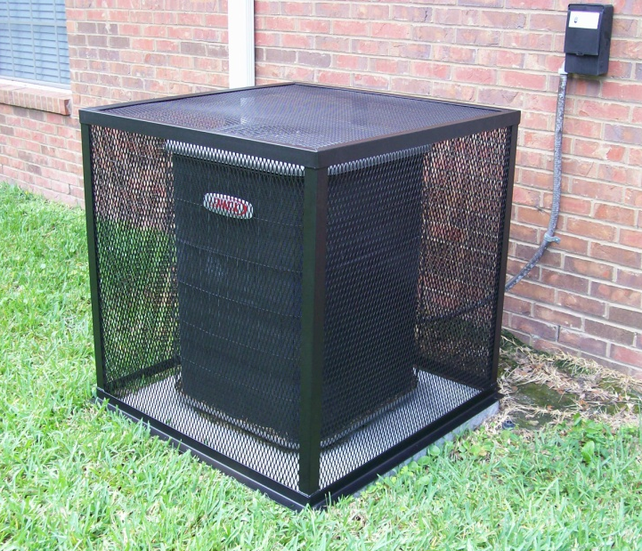
Vulnerability analysis

Slide 31
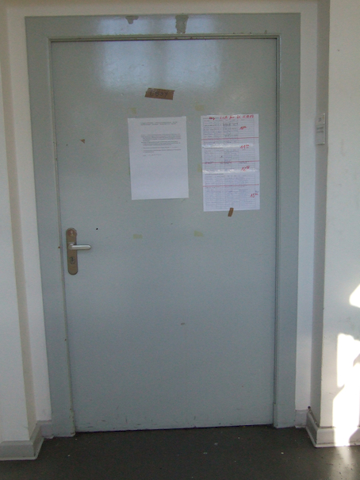
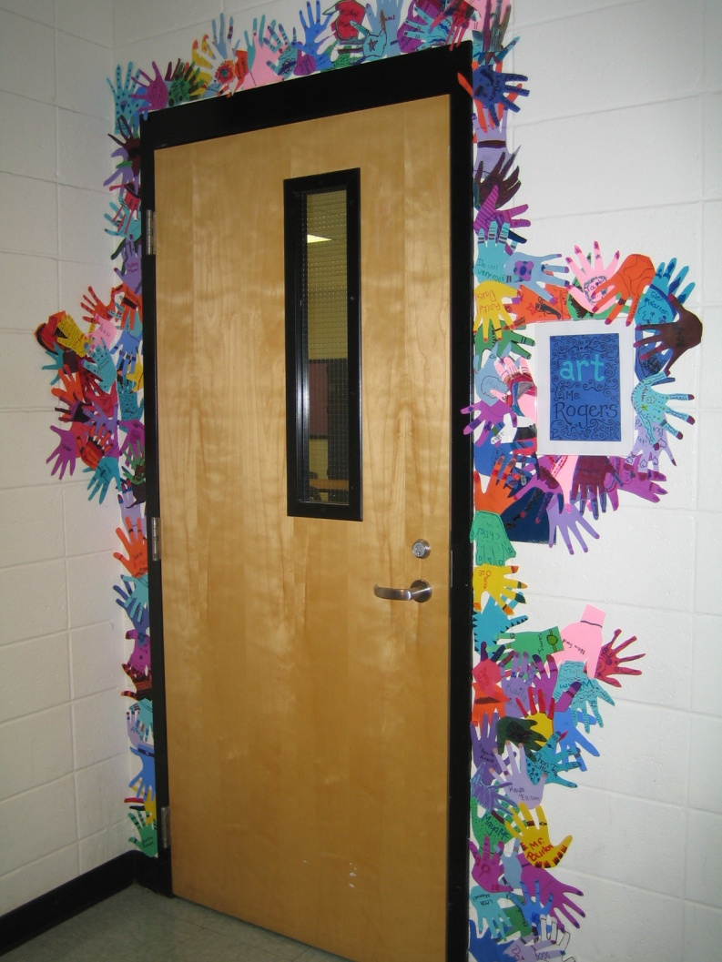
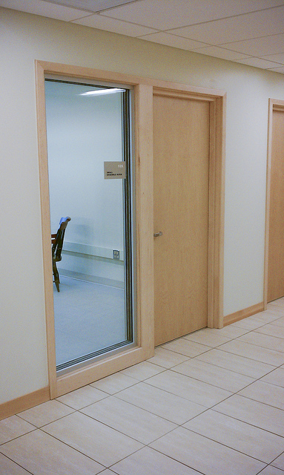
Vulnerability analysis
What is the type of your inside doors?
Traditional Most usual New concept

Slide 32
Vulnerability analysis

Slide 33
Vulnerability analysis
Do you use social media for emergency alerts?

Slide 34
Vulnerability analysis
95%
Do you have a First Aid Kit?

Slide 35
Continuity plan
Action Step #1
Immediate Actions
 to be completed within 12-hours after the event
Action Step #2
Initial Recovery
 to be completed from 12 to 48-hours after the event
Action Step #3
Campus/School Recovery
 to be completed within 1 to 3-weeks
after the event
Action Step #4
Campus/School Opening
Action Step #5
Plan Review

Slide 36
Training

Slide 37
Training

Slide 38
Training
Classmates’ Counter
Door Locker
Status Reporter

Slide 39
Some proposals for now
Update existing plans based on logic, anthropocentricity, collaboration and participation;
If you do not have a plan – ask for specialized consultancy (both State and private);
Balance between a “cool” school and a “safe” school;
Apply pressure for “society-level prevention measures”;
Come closer to student’s families;
Update your brain and delete the
“it will not happen to us!” element
No problem!
THE PROBLEM!

Slide 40
Back to basics …

Slide 41
Thank you for your attention !

Slide 42
School
Extreme Violence
BG(ret’d) John Galatas, MD
Independent Consultant
igalatas@yahoo.com

