Slide 1
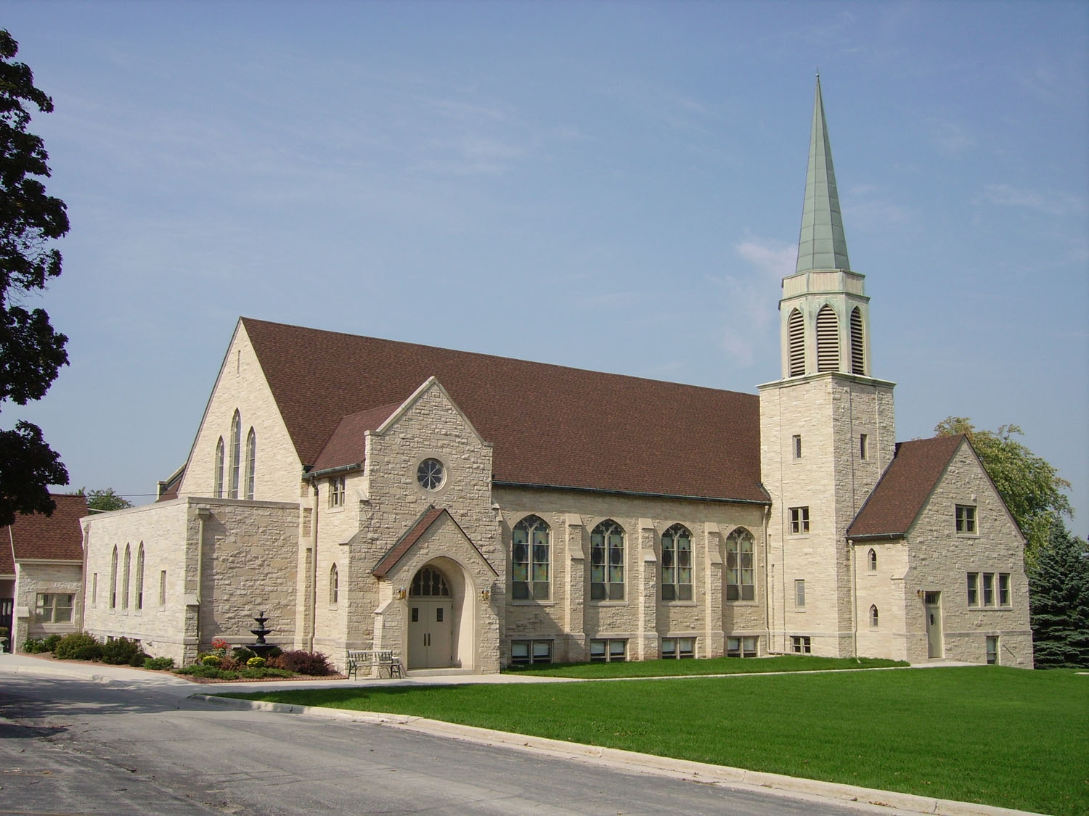
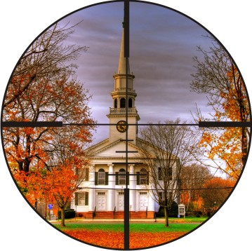
CHURCH
SECURITY
Brig Gen (ret’d) John Galatas, MD
Senior Asymmetric Threats Analyst
Athens, Greece

Slide 2
US Churches
Mega church (MC) Average weekend attendance more than 2,000 people
►Houston: 25 MC
Large church (LC) Average weekend attendance between 301 and 2,000 people
►Houston: 13 LC
Medium church (MDC) Average weekend attendance between 51 and 300 people
►Houston: 44 MDC
Small church (SC) Average weekend attendance fewer than 50 people
►Houston: 30 SC
http://www.usachurches.org/
There are
over 300,000 churches
in the U.S. today
with an average
of 1,500 mega churches
with an attendance
of 2,000.00 or more;
Non-Christian religious congregations are estimated
at about 12,000

Slide 3
US Churches
Approximate distribution of U.S. Protestant and other Christian churches by size
based on National Congregations Study (excluding Catholic/Orthodox)
http://hirr.hartsem.edu/research/fastfacts/fast_facts.html

Slide 4
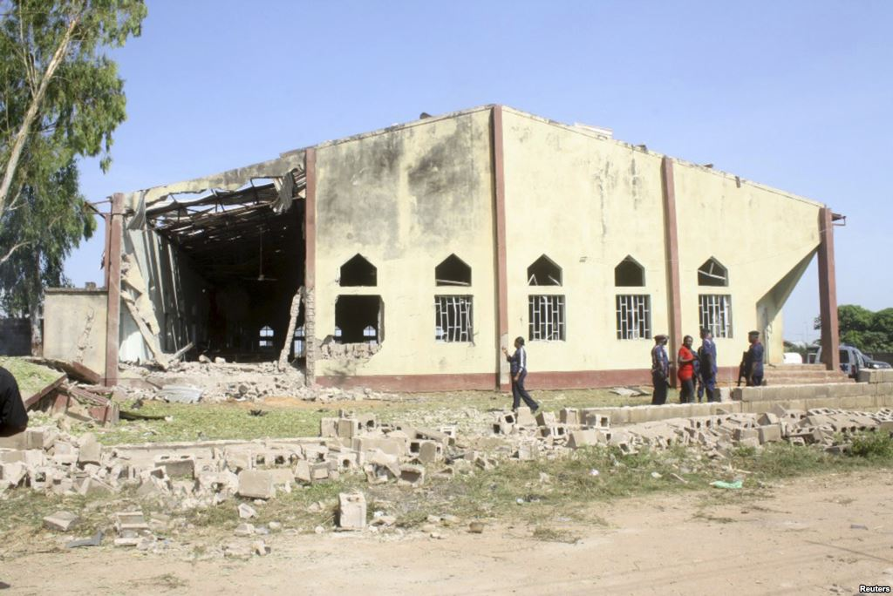
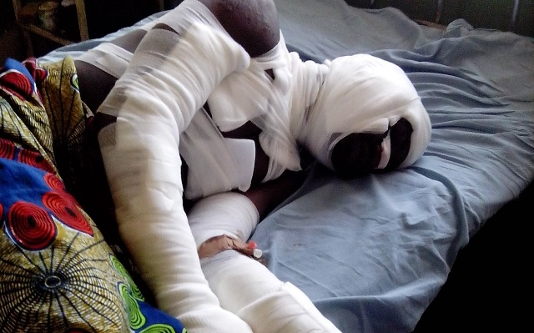
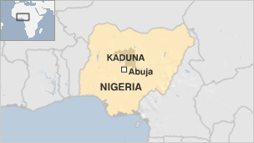
International church violence
October 2012
Nigeria
11 people were killed and 30 injured
when a suicide bomber
attacked St. Rita’s Catholic church
during morning services

Slide 5
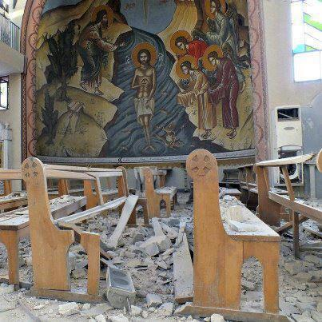
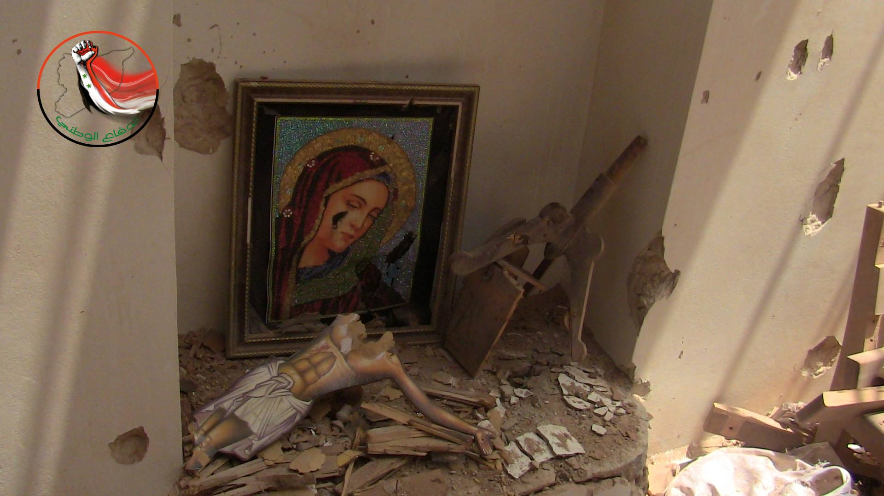
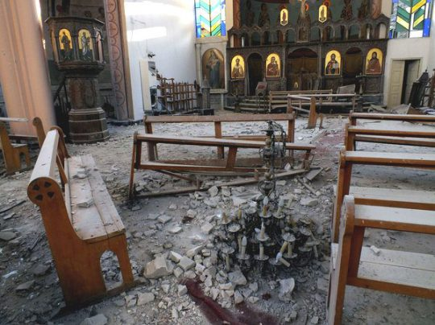
International church violence
Syria 2013

Slide 6
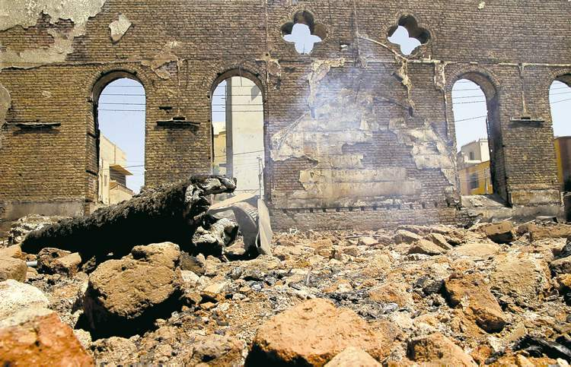
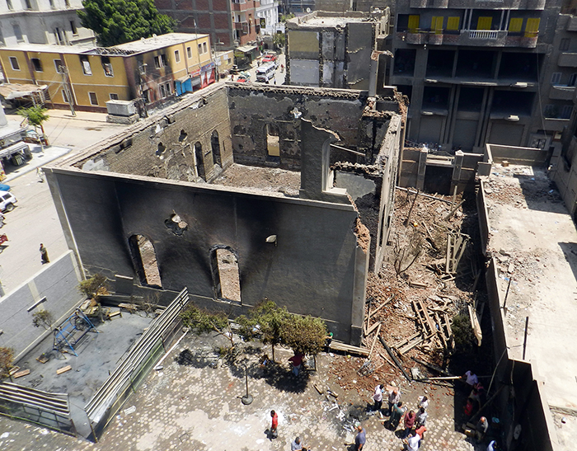
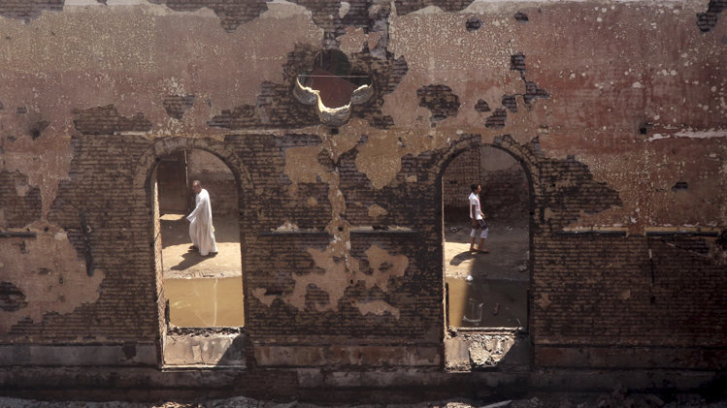
International church violence
August 2013
Egypt
The burnt-out shell of the Evangelical church in Mallawi, in the Minya governate, destroyed in last week's violence by Muslim Brotherhood supporters

Slide 7
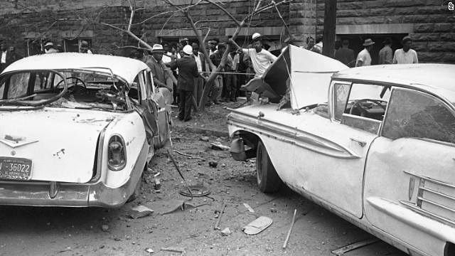
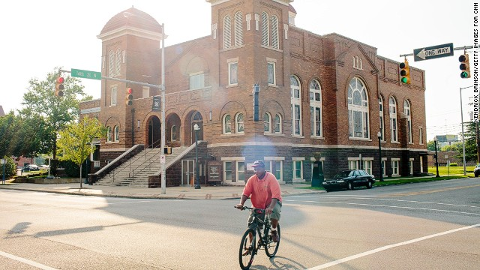
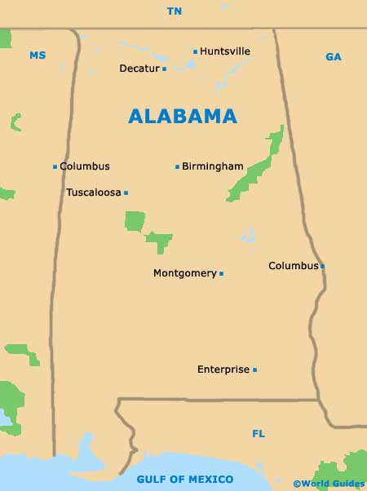
US Church violence
1963
Birmingham, AL
10:22 a.m. on Sunday, September 15, 1963, a stack of dynamite hidden beneath an outside staircase by Ku Klux Klansmen left a massive hole and crater in one side of the 16th Street Baptist Church;
Blast blew out windows, filled the place with dust and debris, and destroyed a ladies restroom in the basement;
Death toll: 4 girls (11-14yrs); two dozen people
injured

Slide 8
US Church violence
June 22, 1980 First Baptist Church ►Death toll: 5 Daingerfield, Texas A gunman attacked the Sunday morning service, coming through the sanctuary doors, yelling “this is war,” and firing into the congregation. He killed a seven-year-old girl, an adult woman, and three adult men in the shooting, which lasted barely one minute.
March 10, 1999 New St. John Baptist Church ►Death toll: 4 Gonzales, Louisiana On a Wednesday an estranged husband with a gun killed his wife’s mother at her home then drove to the church, where he walked into the evening service. When the gunman’s two-year-old son said, “Daddy,” the gunman said, “Boy, don’t call me daddy now,” and killed him. He then killed his wife and a young man sitting nearby.
September 15, 1999 Wedgwood Baptist Church ►Death toll: 9 Fort Worth, Texas A man, distraught over his father’s death, drove to what appeared to be a random location choice where a See You at the Pole celebration rally was being held. He shot his first victim while walking in the lobby doors, asking, “Is this where that (expletive deleted) prayer meeting is going on?” He killed two seminary students, a member of the church staff, and four teenagers before taking his own life.
March 12, 2005 Living Church of God ►Death toll: 8 Brookfield, Wisconsin Angry at his pastor’s sermon, a man left the Sunday morning service and came back in shooting. He killed the pastor and six others before killing himself.

Slide 9
US Church violence
August 28, 2005 Sash Assembly of God Church ►Death toll: 4 Sash, Texas A neighbor of the church walked up to a deacon in the parking lot, whom he shot and killed. He then shot and killed the pastor who was standing nearby. As he fled the scene, he shot and killed two women who had stopped on a road to check their horse trailer.
May 21, 2006 Ministry of Jesus Christ Church ►Death toll: 5; 1 injured Baton Rouge, Louisiana An estranged husband attacked his wife in church, killing four others as he stormed into the service. He kidnapped his wife out of the church and killed her at another location. He also shot and critically wounded the pastor.
December 9, 2007 YWAM (Arvada) and New Life Church (Colorado Springs) ►Death toll: 4 + 6 Arvada and Colorado Springs, Colorado In the early morning hours, 24-year-old Matthew J. Murray opened fire at the Youth With A Mission training center in Arvada, Colorado, with a pistol, killing two and wounding two others before escaping. Later that afternoon, he attacked the New Life Church in Colorado Springs, Colorado, with a number of firearms, killing two more people and injuring three before being shot and wounded by a former Minneapolis police officer; he then committed suicide.
March 31, 2013
Hiawatha Church of God ►Death toll: 1
Ashtabula, Ohio
25 year old Reshad Riddle fatally shoots his father, 52 year old Richard Riddle, with a single shot from a handgun.

Slide 10
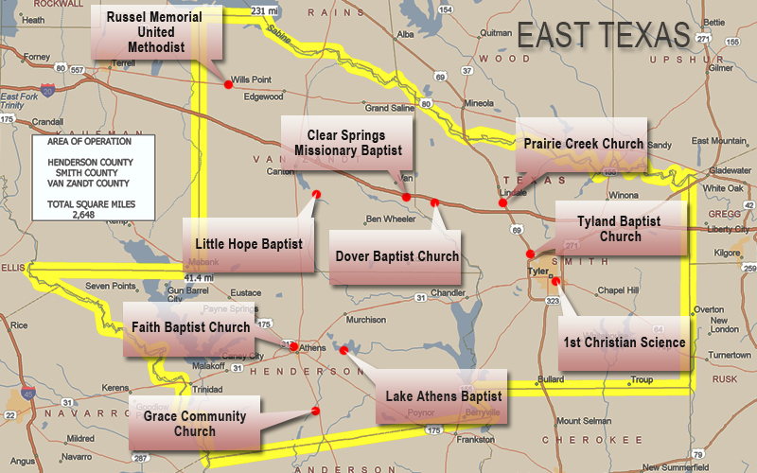
US Church violence
April 13, 2010
East Texas
No more church arsons have been reported since the arrest of Jason Robert Bourque and Daniel McAllister who are charged with the East Texas fires. String of attacks caused many religious leaders to rethink the security of their church facilities
http://thebells.umhb.edu/2010/04/13/church-security-evaluated/

Slide 11
US Church violence
http://www.carlchinn.com/Church_Security_Concepts.html

Slide 12
US Church violence
http://www.carlchinn.com/Church_Security_Concepts.html

Slide 13
US Church violence
http://www.carlchinn.com/Church_Security_Concepts.html

Slide 14
US Church violence
http://www.carlchinn.com/Church_Security_Concepts.html

Slide 15
US Church violence
http://www.carlchinn.com/Church_Security_Concepts.html

Slide 16
US Church violence
http://www.carlchinn.com/Church_Security_Concepts.html

Slide 17
US Church violence
Where attacks occurred by denomination
Baptist
Non-denominational
>50%
Catholic
http://www.carlchinn.com/Church_Security_Concepts.html

Slide 18
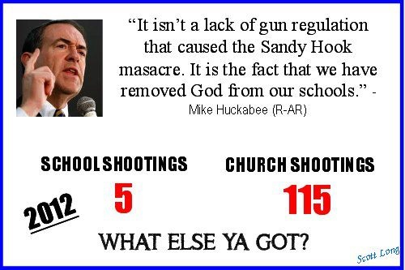
US Church violence

Slide 19
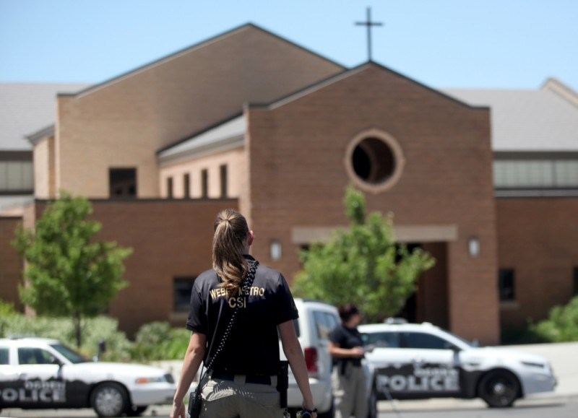
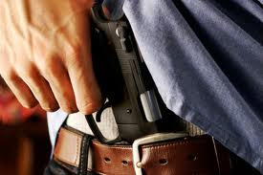
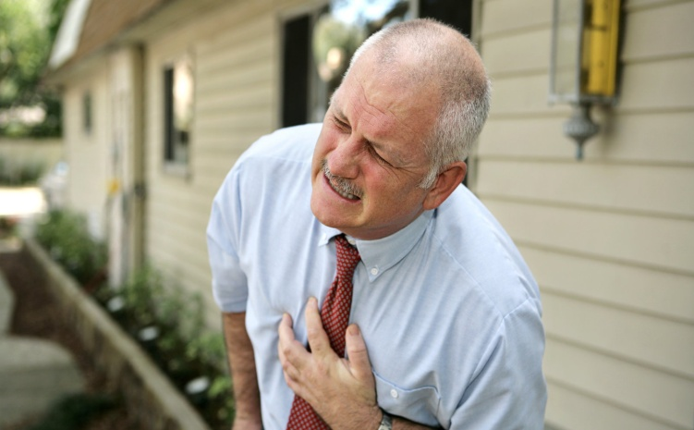
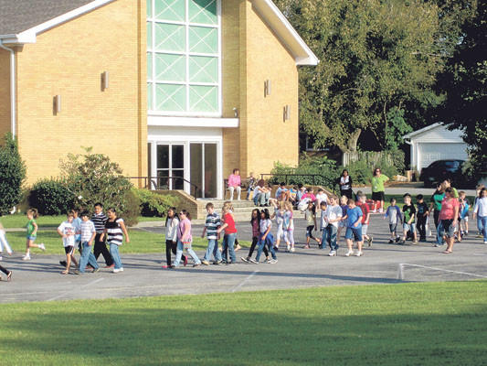
Security concerns
Violent incidents
Disruptive incidents
Missing children
Domestic violence on church premises
Medical emergencies
Weather emergencies
Lockdowns and evacuations

Slide 20
Important questions
1) Do you have an emergency plan should a major catastrophe such as a fire occur?
2) Are you prepared to respond to a medical emergency during worship service?
3) Do you monitor your church parking lot prior to service and during service?
4) If a child care program exists are all volunteers screened for a criminal background?
5) Are there security strategies in place to protect children while in church custody?
6) Is the outside of your church inviting to burglars or those seeking to vandalize?
7) Do you maintain shrubbery around your facility?
8) Is outside and interior lighting adequate?
9) Do you have emergency and back-up lighting?
10) Are all doors and windows secured when building is empty?
11) Do you inventory all major equipment annually?
Are serial numbers or other key identifiers located or placed on key
assets recorded in case a theft occurs?
Is there a process in place to ensure the protection and integrity
of your collections?
Have you a plan in place in case a person walks down the aisle with a gun?
If not, items #3 and 15 are a start.
15) Does your church have a trained security team?

Slide 21
Security strategies
Crime Prevention Through Environmental Design
 manipulating the built environment such as landscape designs,
natural surveillance, and using structures to divert or influence flow;
Physical security monitoring
 alarms, cameras, access control;
Security/terrorism awareness training for faith leaders;
Establish a security committee that produces preparedness plans; and
Foster positive relationships with local law enforcement

Slide 22
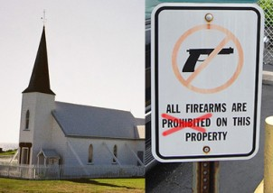
Critical security tips
1. Background Checks (volunteers) – complete background checks through experienced firms
 Searches don’t look beyond national databases into county criminal records, social
security records or maiden name records
►9% of church volunteers and staff have a flagged profile ; 4% have criminal histories;
►Child abuse in churches: 90% of sexual predators not being in any criminal database
2. Check-in System – a secure check in system for children & events
 Computer check-in system; name tags; children delivery protocol; medical info
3. Aggressive Friendliness – training to intervene with difficult people politely
 A de-escalation technique aimed at gently confronting the individual in a non-threatening way.
4. Emergency Action Plan – steps to identify, evaluate and respond to an emergency
Medical Emergencies
Power Outages
Evacuation Plans
Bomb Threats
Fire Drills
Lock Down Procedures
Security
Coordination Training
Churches that are designated gun free zones are at much higher risk of large scale loss of life than those that have the option of armed responders who can react immediately.

Slide 23
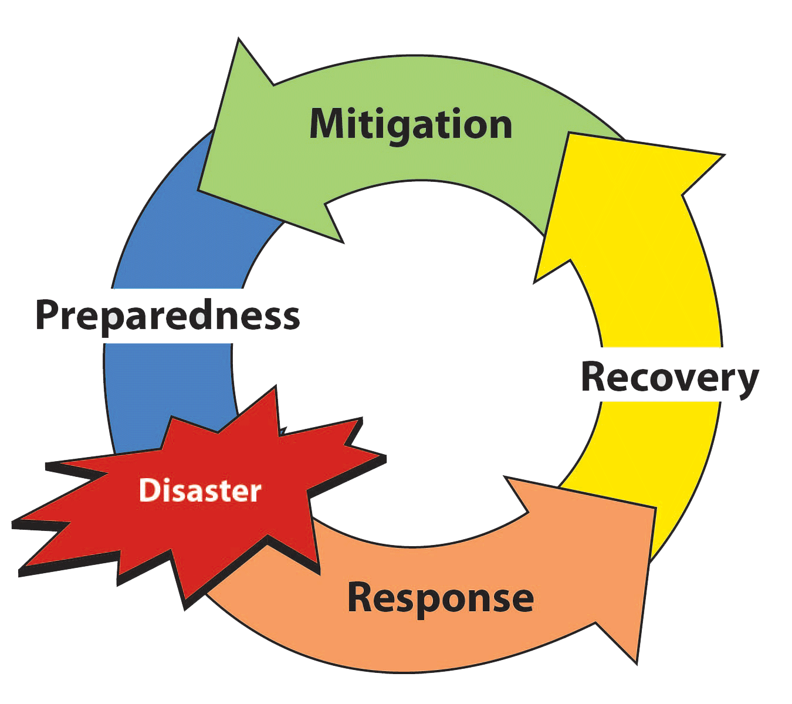
Critical security tips
5. Triage Teams – recruit paramedics, doctors & nurses for medical situations
 Small volunteer teams of doctors, nurses and paramedics (local
response or dial 9-1-1)
6. ERT kits – Emergency Response Team kits to be used in case of emergency
 ERT kits should include large, reflective vests, powerful
flashlights, additional emergency radios, and building maps;
►By placing emergency response team kits at strategic locations
around the campus, distribution is made easier in the midst of an
emergency
 Is your First Aid Kit a modern one? – new materials can
save lives before paramedics arrive!
7. Communications – command and control for instant communications and coordination
 Two-way radio systems over cell phones because the radios
are not dependent upon cell towers or keeping an up-to-date
list of cell phone numbers;
►Do not have one in place? Provide bullhorns to key
security team leaders

Slide 24
References
Church shootings on rise in U.S.
http://www.wnd.com/2007/12/45077/
Security!? In a church?
http://www.carlchinn.com/Church_Security_Concepts.html
Siblings of the bombing: Remembering Birmingham church blast 50 years on
http://www.cnn.com/2013/09/14/us/birmingham-church-bombing-anniversary-victims-siblings/?hpt=hp_t3
Shootings: Schools vs. Churches
http://www.patheos.com/blogs/exploringourmatrix/2013/02/shootings-schools-vs-churches.html
Protecting Your Church Against Violence
http://www.sbclife.net/Articles/2013/03/sla17.asp
Armed security in churches - should churches prepare for possible terrorist incidents?
http://www.cknj.com/content/armed-security-churches-should-churches-prepare-possible-terrorist-incidents
Churches have always been viewed as a “Soft Target”
http://www.churchsecurityonline.com/?tag=soft-target
Security Challenges for Houses of Worship
http://jps.anl.gov/Volume4_iss2/Paper1-BMHarrell.pdf
Church arsons
http://thebells.umhb.edu/2010/04/13/church-security-evaluated/
Religion & Public Life Project
http://religions.pewforum.org/maps

Slide 25
CHURCH
SECURITY
BG(ret’d) John Galatas, MD
Independent Consultant
igalatas@yahoo.com

